Slide 1
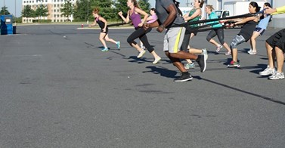
k
STOP dieting
STOP ignoring pain
STOP making exercise last on your priority list
STOP believing that showing up is good enough
STOP repetitive behaviors which bring zero results
STOP following conflicting advice, pick one trustable source STOP skipping strength training
www.CFCFitness.com

